Slide 1
Creating Embeddings for Neural Networks

Slide 2
Project Idea
Came up with idea for final research project.
Research Question: Can neuron/unit embeddings based on activation patterns improve the understanding of deep neural networks?

Slide 3

Embeddings
Idea originally from word2vec
word2vec was made by researchers at google
Embeds the meaning of words into vectors
Uses skip gram model
Analogy tests
Other 2vec embedding methods were created such as node2vec

Slide 4
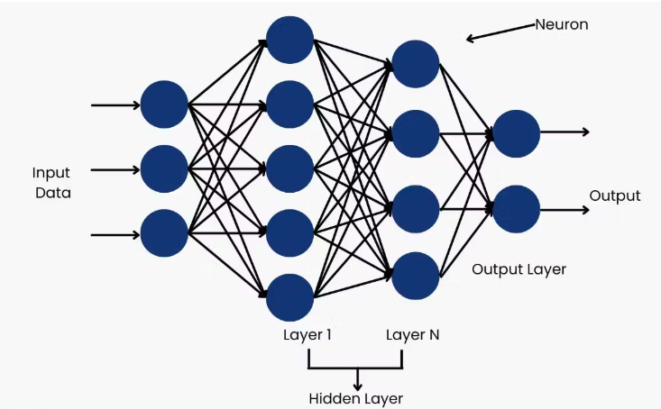
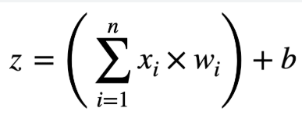
Neural network neurons
A neural network is made of neurons
Each neuron is made of weight, scalars
from the previous layers, and biases

Slide 5
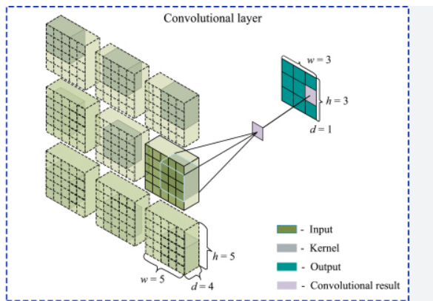
Convolutional Neural Network Units
In a convolutional neural network there are convolutional layers
A kernel is applied in a matrix to one pixel and its surroundings, they are then summed up
This is called a unit, equivalent to a neuron in the hidden layers

Slide 6
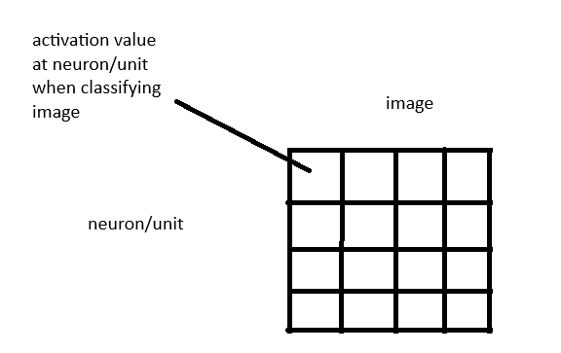

First step in methodology
Trained a simple convolutional neural network on dataset CIFAR10
Used pytorch hooks to capture activation values when running 500 test images through

Slide 7

Second Step in Methodology
Creating a Graph with previously generated matrix
Comparing row
Cosine similarity, threshold .7

Slide 8
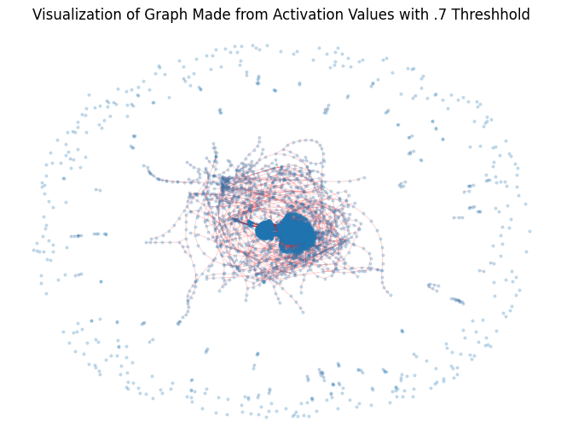
Resulting Graph

Slide 9
Third Step in Methodology
Used Node2vec on Graph
Node2vec
Embeds meaning of nodes in dimensional space
Random walks through graph starting at each node to find community structure
“sentences” are built from these random walks
Same methodology as word2vec from here

Slide 10
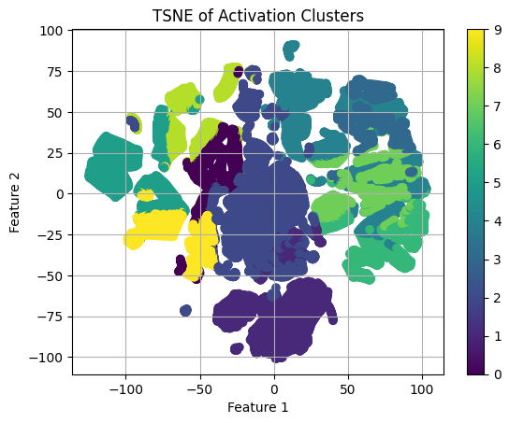
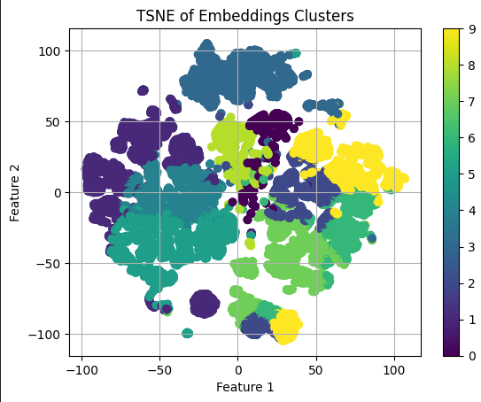
Final Results
Comparing the results of the embeddings with the plain activation values
cluster with kmeans=10

Slide 11
Final Takeaways
Shows some promise
Many more avenues to explore
network dissection
more computation

